Slide 1
Online Banking/Mobile Banking
By
Rakibul Islam
rakib33mbstu@gmail.com

Slide 2
Online Banking/Mobile Banking
Under Developing…..
Its has two parts .
1. Server End
2. Client End
Client End has two parts.
1. Browser Client
2. Mobile Client
Hear I will Show Server End or Back End Process.
Client End Process are Available in www.tk2bd.com
Mobile version /apk are coming soon…

Slide 3
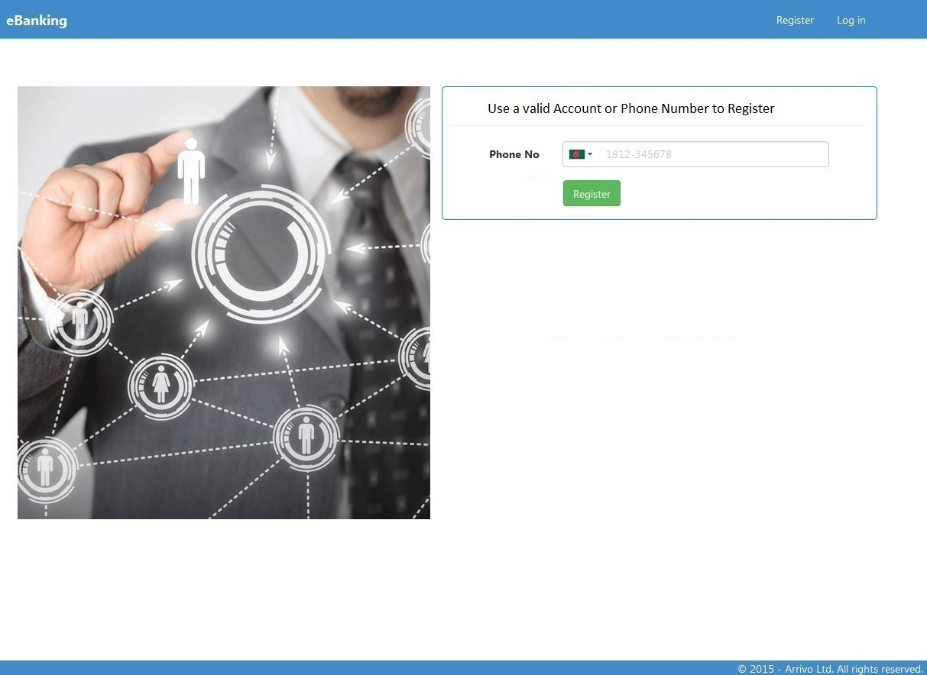
User Registration

Slide 4
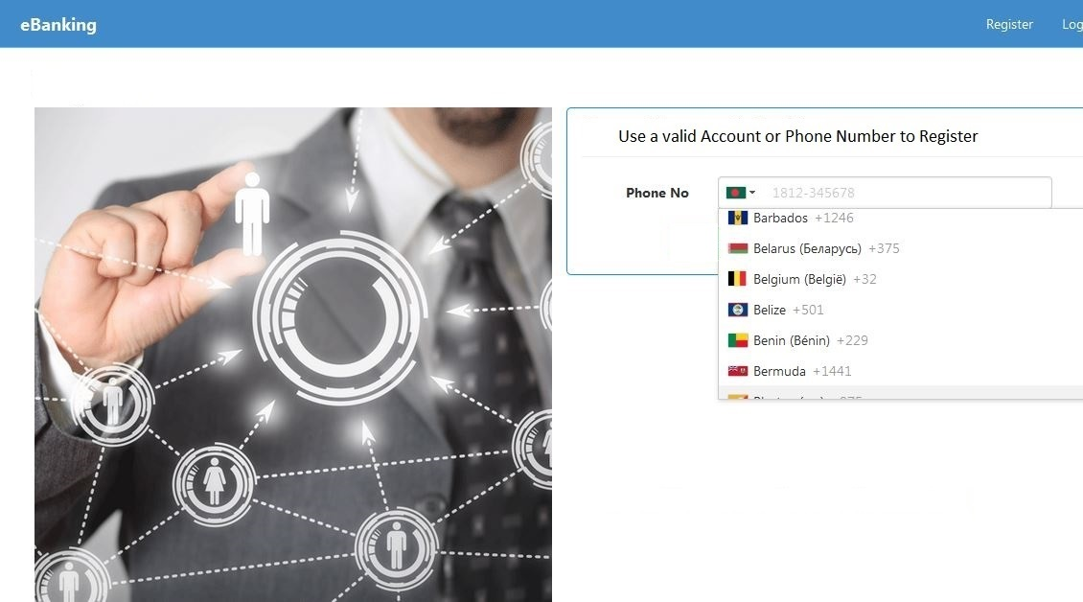
Register Using Valid Phone Number

Slide 5
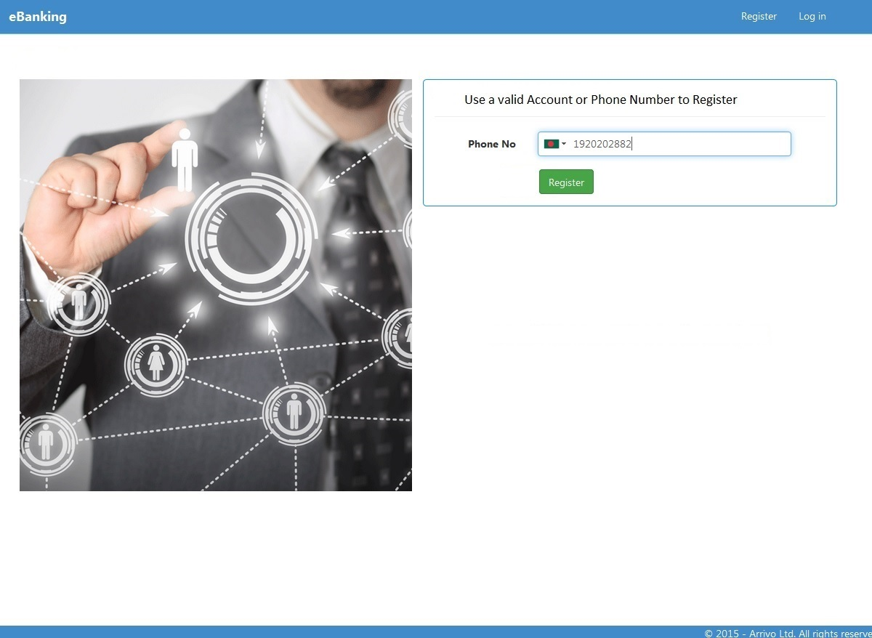
Register Using Valid Phone Number
I registered using my phone number.

Slide 6
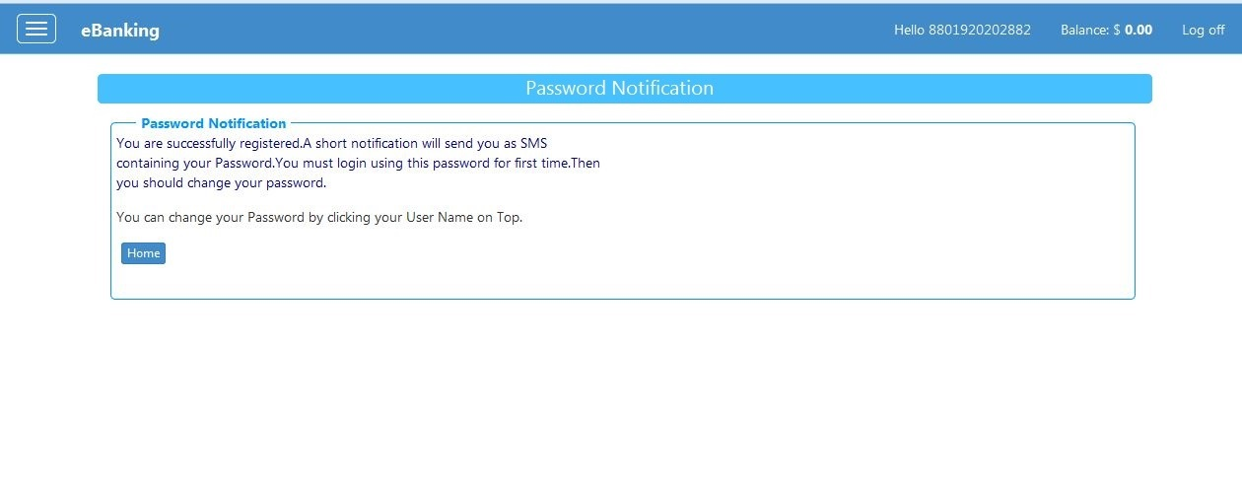
Password Notification
After registration a password notification will shown . Password send to user
mobile via SMS.

Slide 7
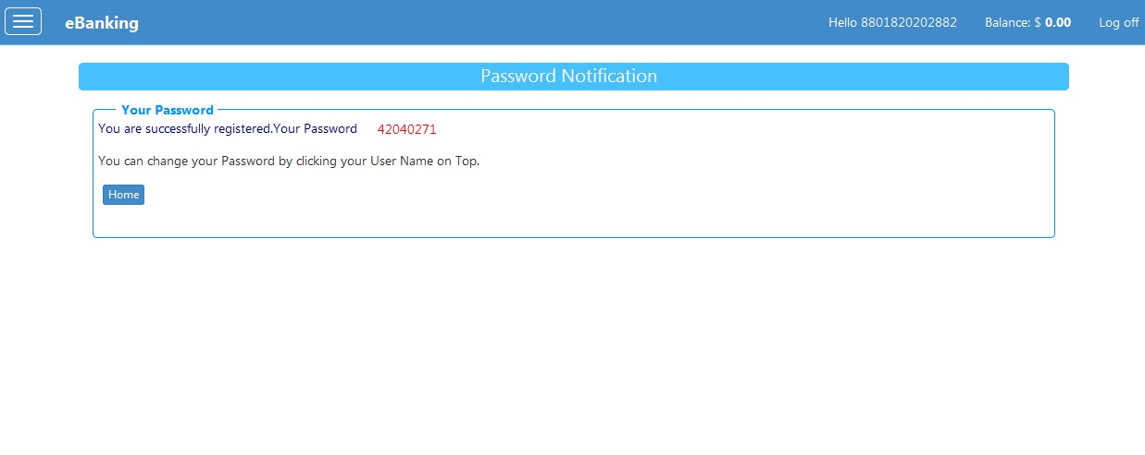
Password Notification Browser View
After registration a auto generated password will given to you via sms . Hear I show this on browser .You can change your Password

Slide 8
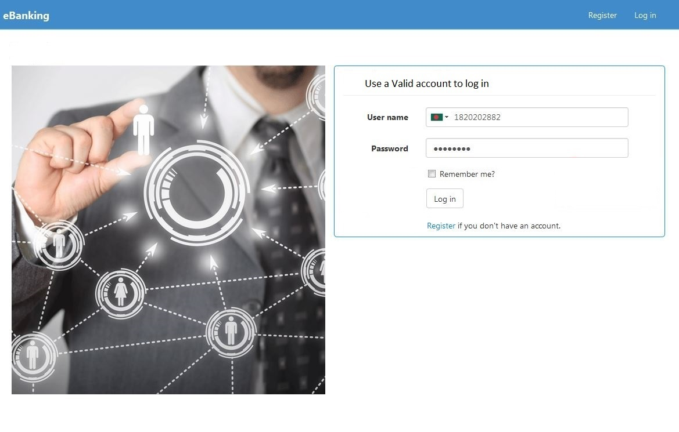
Log In
login with wrong password.

Slide 9
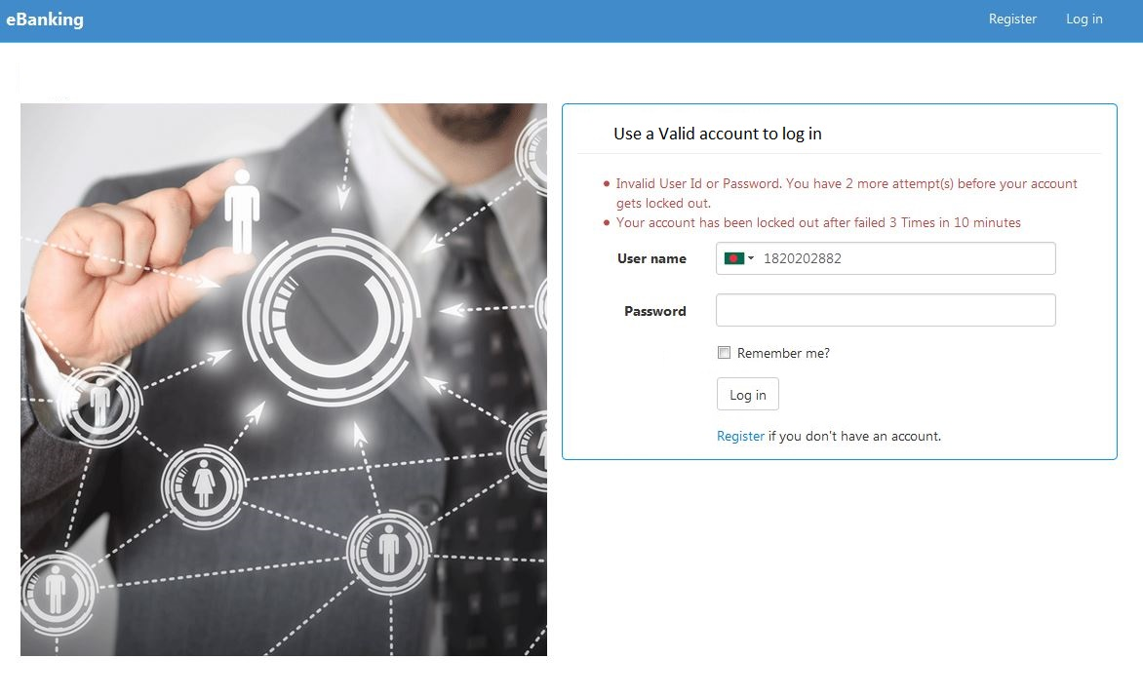
Log In
Login Failed message and user has 2 times in 10 minute to login . If failed
Then user locked next 5 minutes.

Slide 10
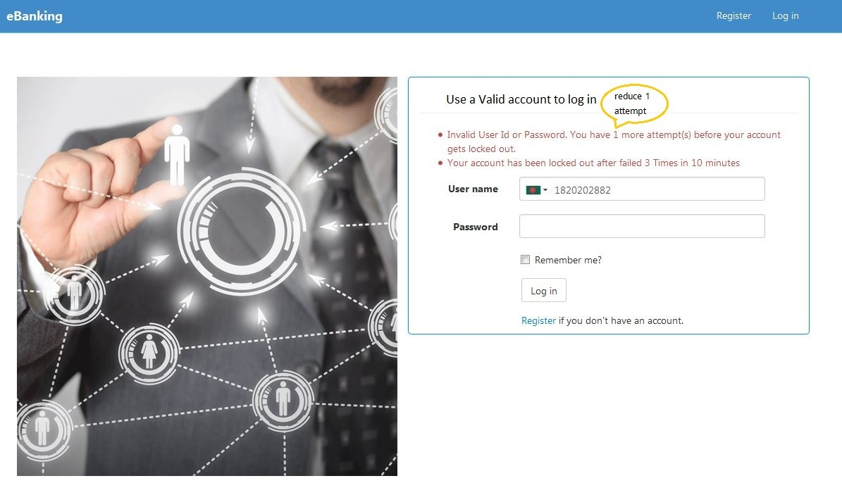
Log In
Login again with wrong password give message user has 1 times in 10
minute to login . If failed Then user locked next 5 minutes.

Slide 11

Log In
Locked after 3 times failed within 10 minutes.

Slide 12
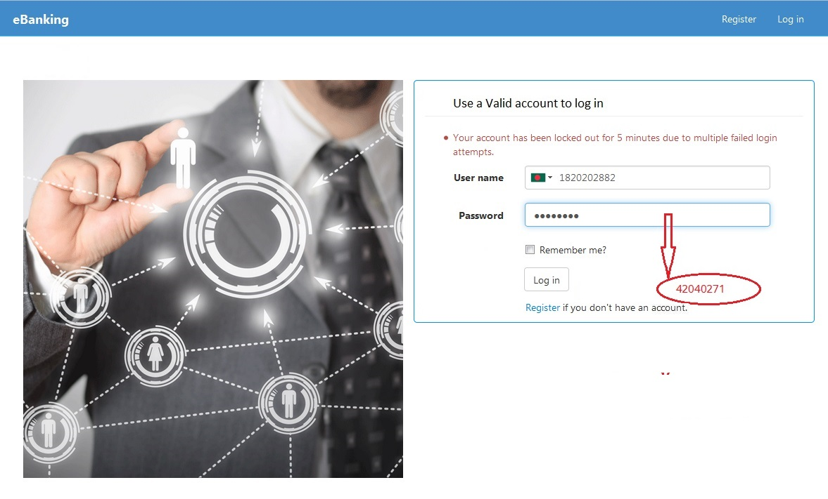
Log In
Login after locked with correct password. But in 5 minutes it does not Sign In.

Slide 13
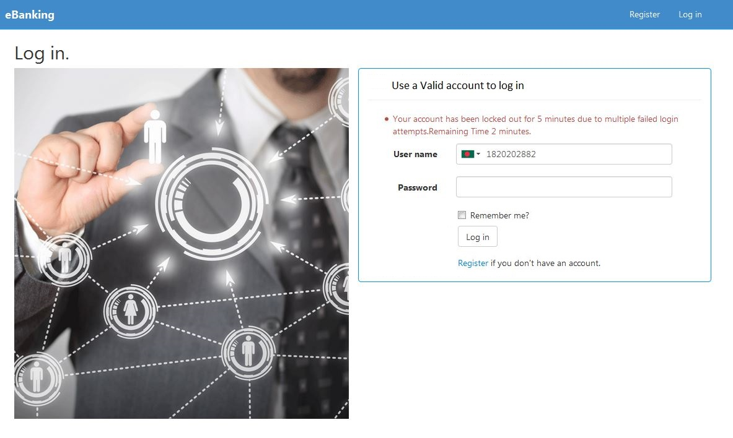
Log In
Login after locked with correct password. But in 5 minutes it does not Sign In and show remaining time (in image 2 minutes).After remaining time over you can try again.

Slide 14
Recharge
User should recharge amount to transfer money or other currency .
This recharge system is as like mobile card system.
User should buy a card or pin. Pin is created with different value .
Such as 100 USD or 1000 USD or many.
Lets see how we create pin with different value

Slide 15
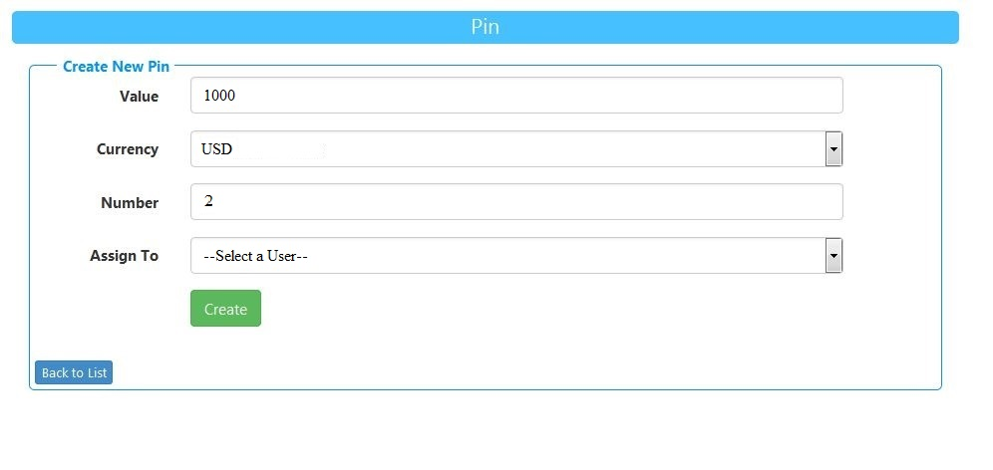
Pin Creation
Create a Pin with value 1000 dolor.

Slide 16
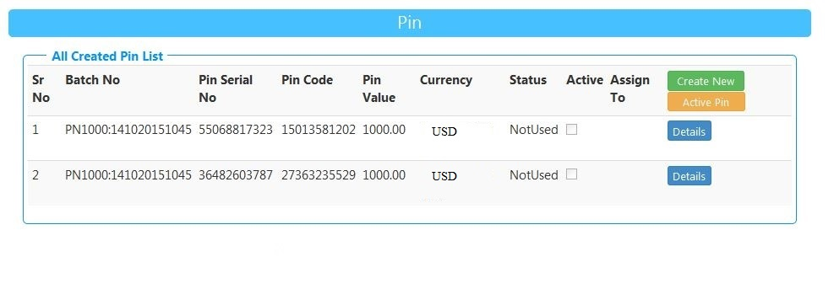
Created Pin list
After creating pin of USD 1000.The Pin Serial No and Pin Code is auto generated . Only Not Used Pin can be usable.

Slide 17
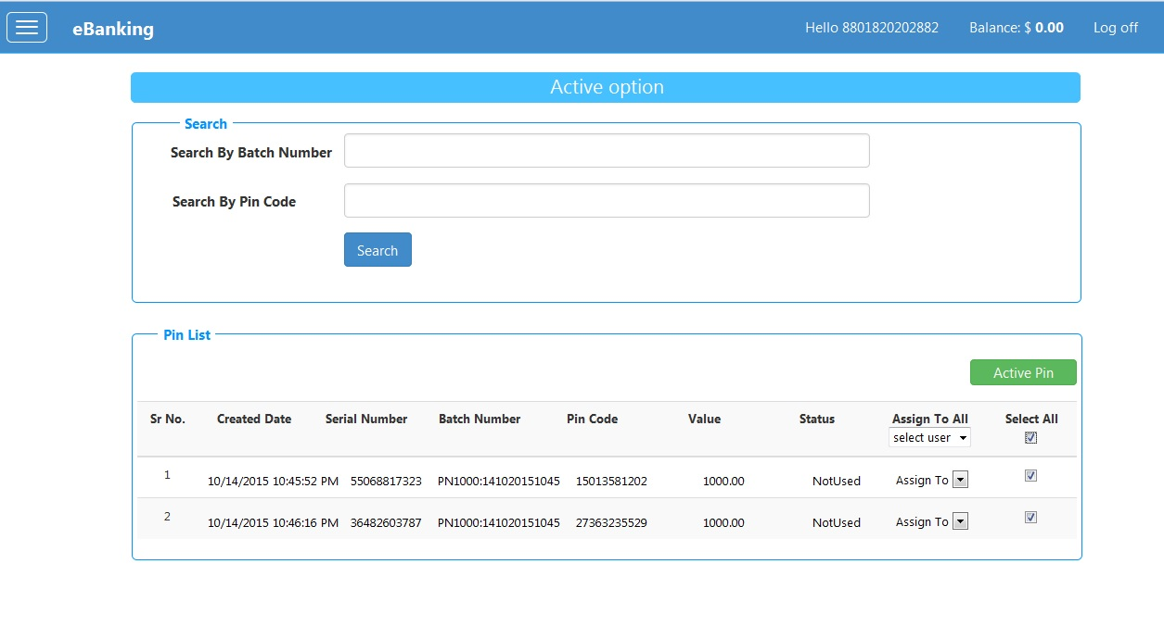
Created Pin Activation
Active this created pin. This task is performed by Admin or an Authorized user
selected by Admin.

Slide 18
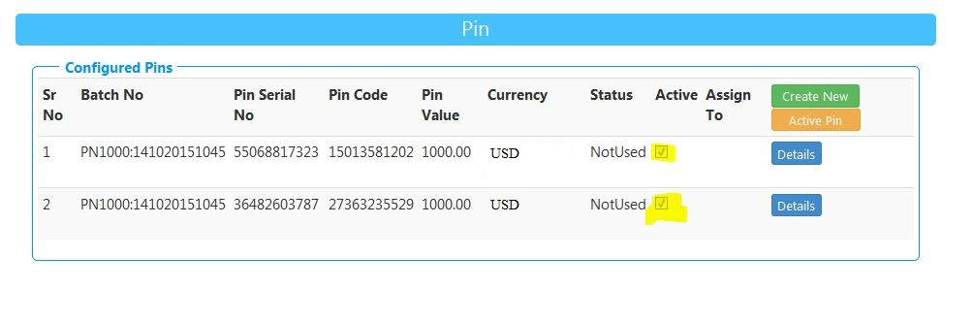
After Activation

Slide 19
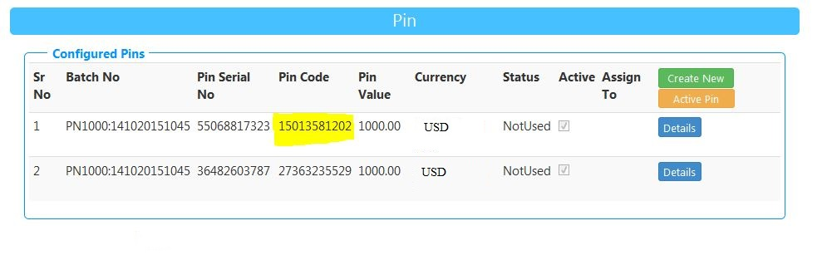
Select a Pin Code for Recharge

Slide 20
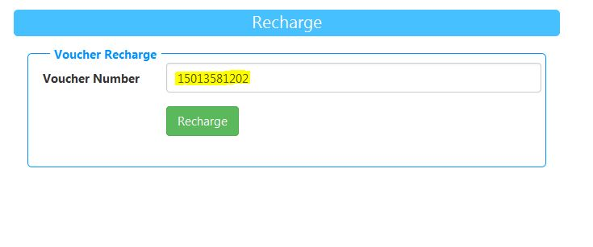
Recharge using Pin
By Buying selected Pin Code you can recharge. We say Voucher Recharge.

Slide 21
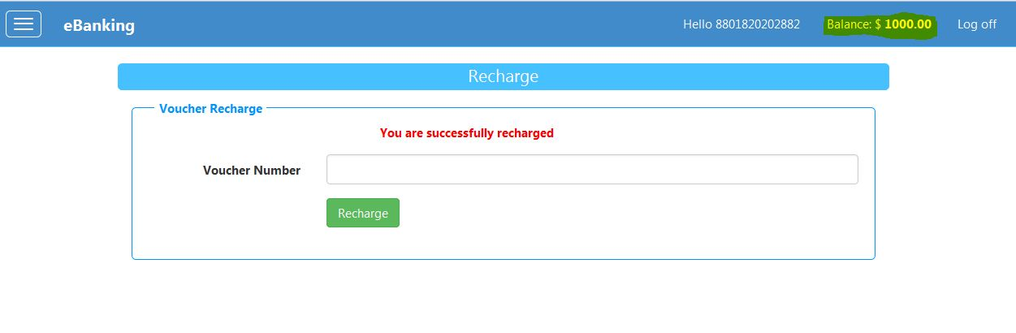
After Recharge
After recharging your balance will increase (see in top).Now you can transfer money.

Slide 22
Money Transfer
Money Transfer form .
you can send money any mobile number under this service.
In Amount field BDT money will inserted .
Its corresponding USD will be automatically changed.
If you have no money you are restricted to transfer money.
Also any one can send money to your account using this form.
After transfer any amount your Balance will reduce automatically .
If transferred failed your Balance will automatically adjusted . This task done in background of the project.

Slide 23
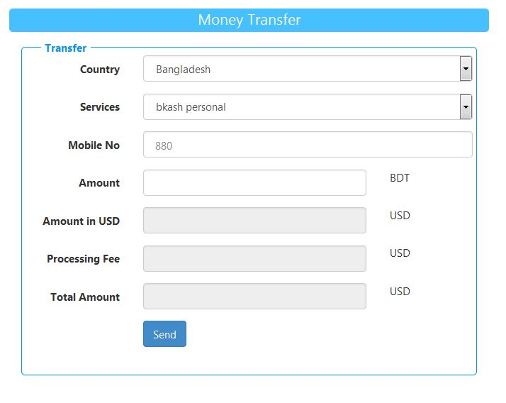
Money Transfer Form

Slide 24
Conclusion
Many others task are done.
I just show some hear.
Global vendor are coming .
We are busy to work with this vendor.

Slide 25
Thank You !!

